Slide 1




What is Big Data?
And Why it Matters to You!
Shannon McWeeney, PhD
13th January 2016

Slide 2
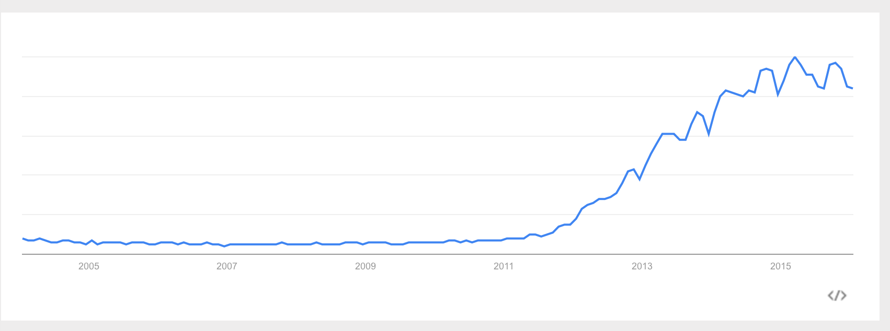
Google Trends: “Big Data”
Interest over time
Chart created 13th January 2016

Slide 3
What is Big Data?
Interactive Q&A

Slide 4
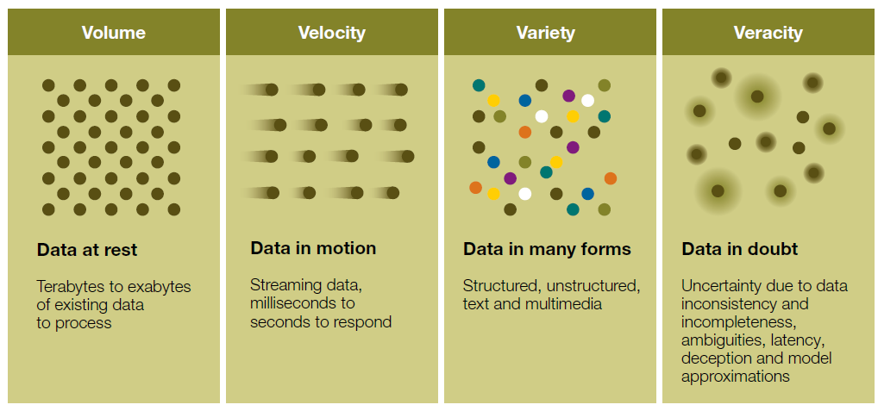
The 4 V’s

Slide 5
What does this mean?
Why does this matter to me?
Notes:
VERACITY – UNCERTAINTY VAREITY – DIFFERENT FORMS VOLUME – SCAEL VELOCITY- STREAMING

Slide 6
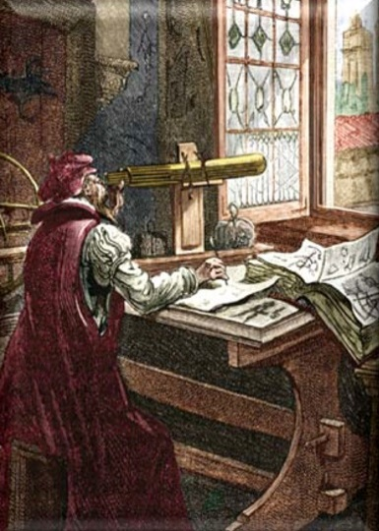
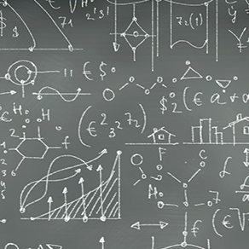

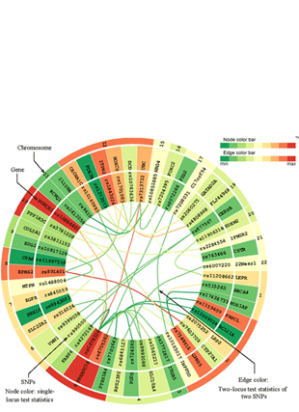
The Fourth Paradigm*
First
Second
Third
Fourth
DESCRIPTIVE
THEORETICAL
COMPUTATIONAL
EXPLORATION
*Jim Gray, Microsoft

Slide 7
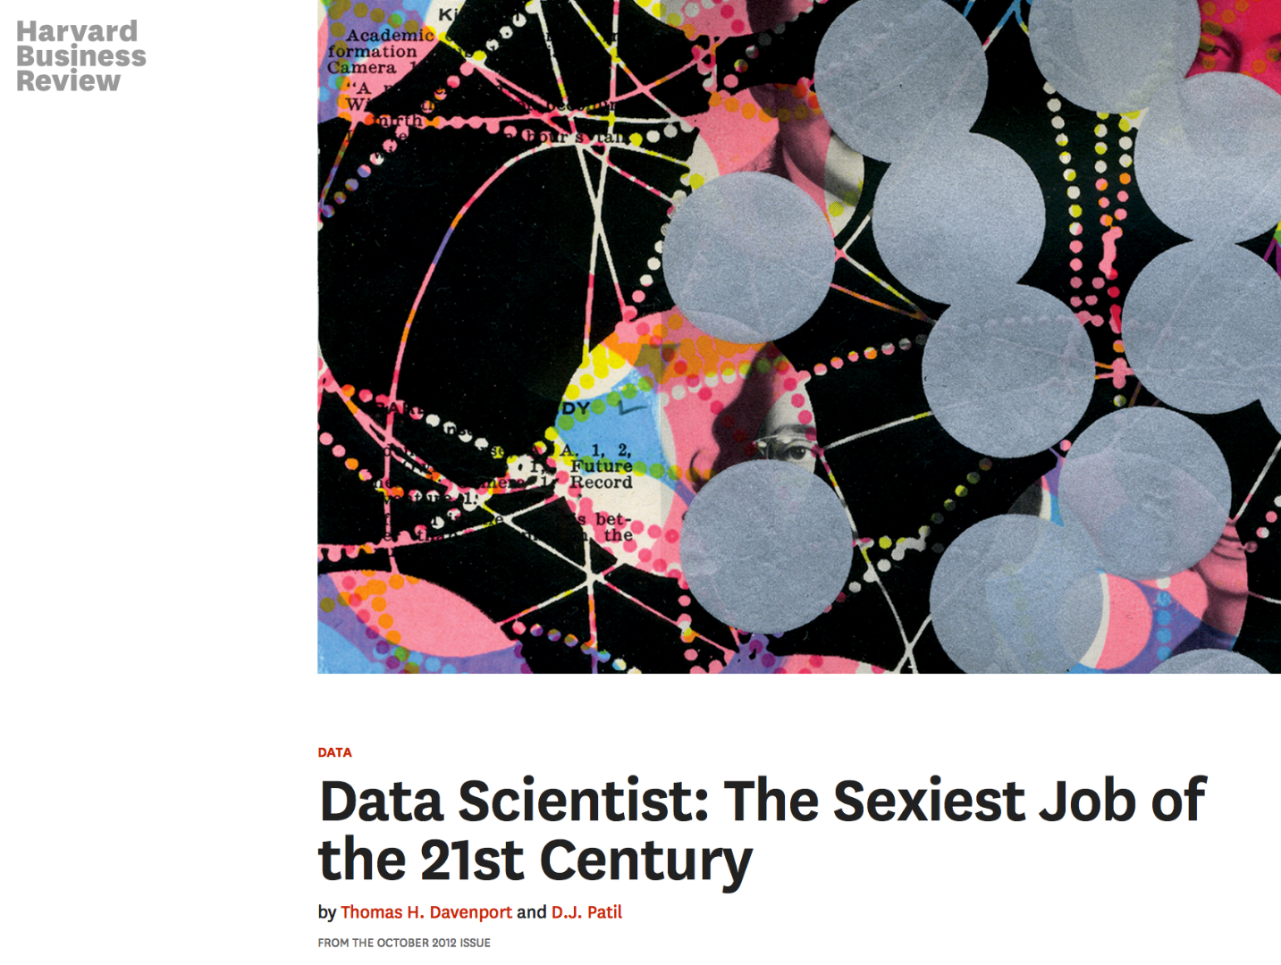
Career Prospects

Slide 8
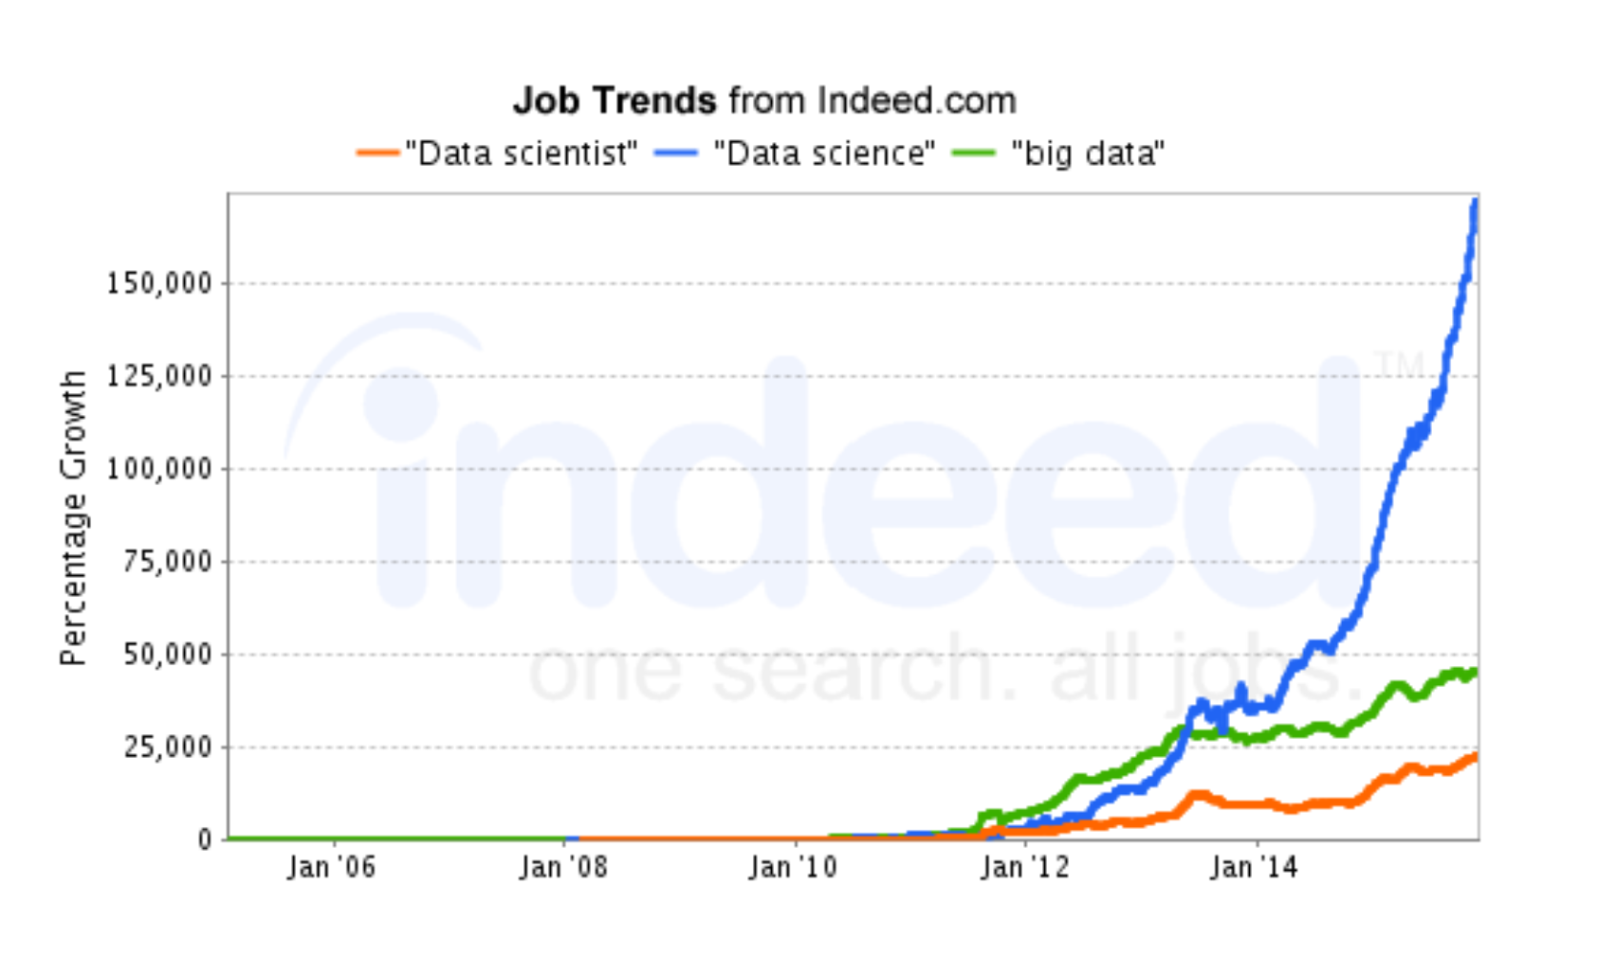
Career Prospects
Chart created 13th January 2016

Slide 9
Career Prospects
Chart created 13th January 2016

Slide 10
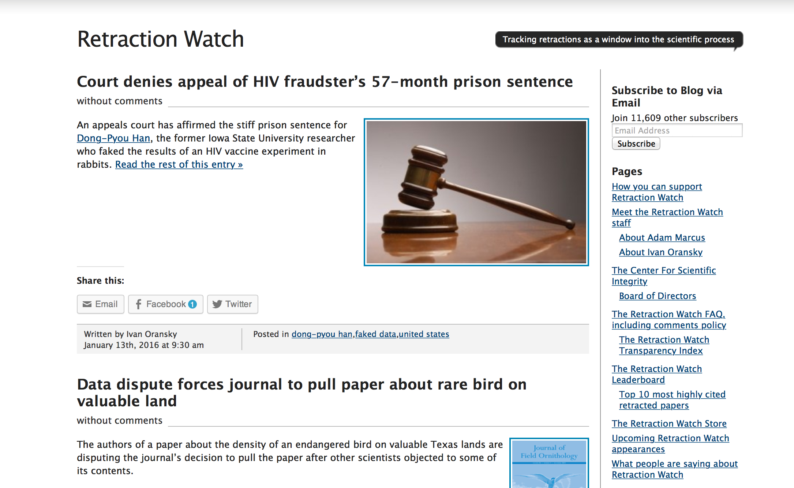
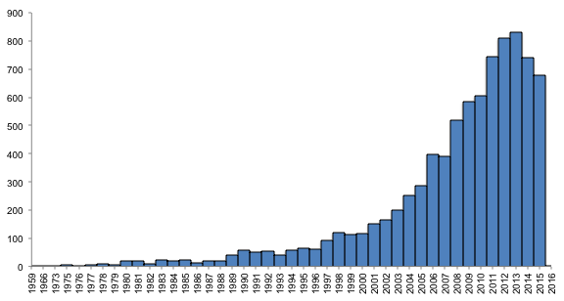
Scientific Considerations
Pubmed - ("retraction of publication"[Publication Type]) OR "retracted publication"[Publication Type]
Notes:
Chart created 13th January 2016

Slide 11
Quantifying Data
Quantified Self and Your Personal Data

Slide 12
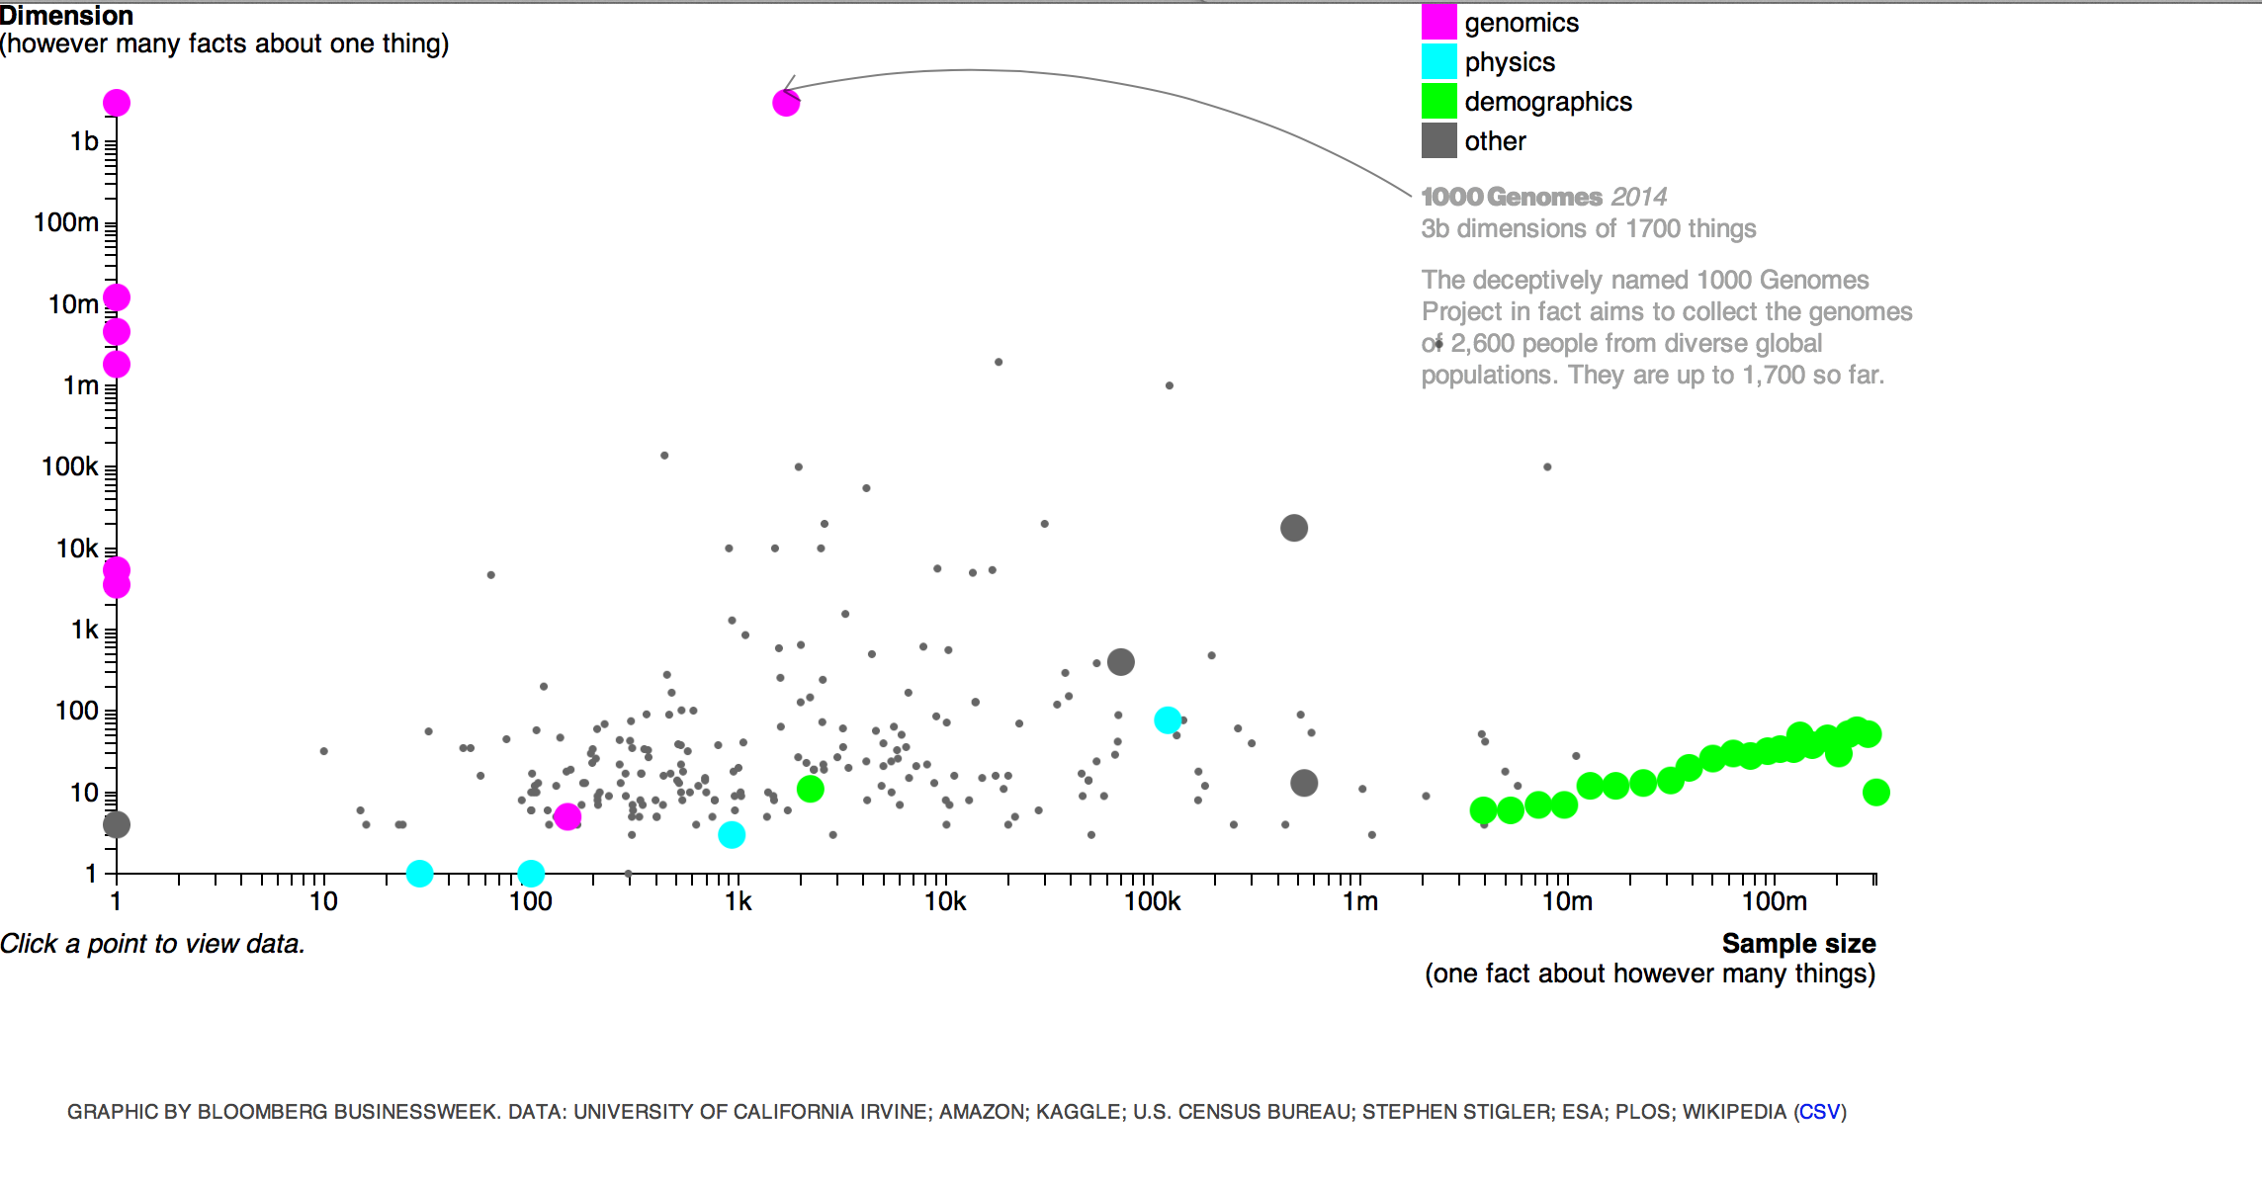
Quantifying Data
Notes:
http://www.businessweek.com/graphics/2014-03-bigdata/

Slide 13
How much data do you generate?
Quantifying Personal Self

Slide 14
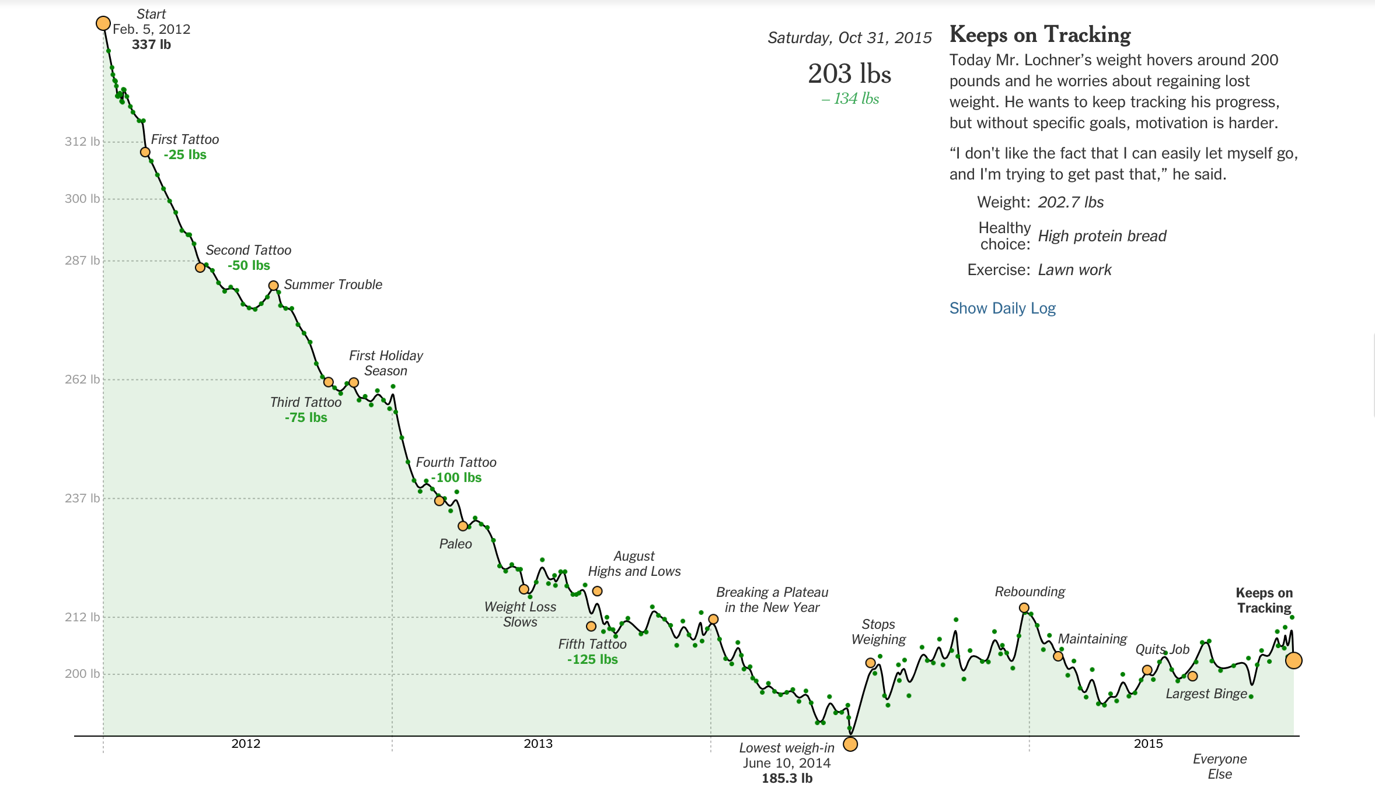

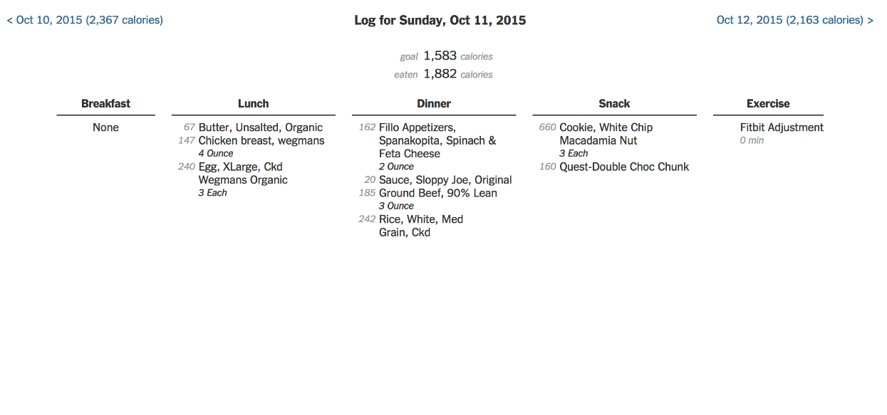

Data: Steve Lochner; Graph: New York Times
Notes:
http://www.nytimes.com/interactive/2015/11/17/health/wiredwell-food-diary-super-tracker.html?_r=0

Slide 15
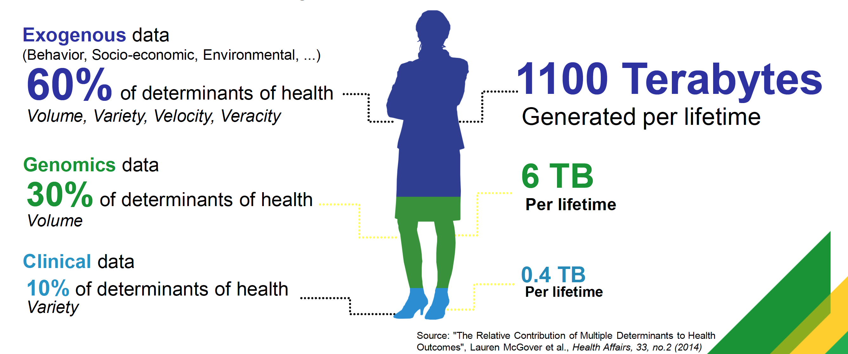
Quantifying YOUR Data
Image: IBM

Slide 16
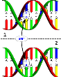

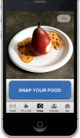
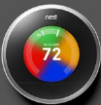
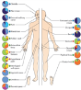
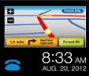
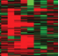

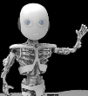
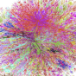



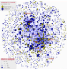
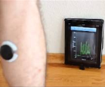

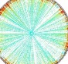
Personal Information Streams
‘Omics’
Traditional
Quantified Self
Internet-of-Things
Genome:
SNP mutations Structural variation
Epigenetics
Personal and Family Health History
Self-reported data: health, exercise, food, mood journals, etc.
Smart Home
Microbiome
Prescription History
Smart Car
Transcriptome
Mobile App Data
Lab Tests: History and Current
Personal Robotics
Metabolome
Quantified Self Device Data
Environmental Sensors
Proteome
Demographic Data
Diseasome
Community Data
Standardized Questionnaires
Biosensor Data Objective Metrics
Environmentome
Legend: Consumer-available
Image: Melanie Swan
16

Slide 17
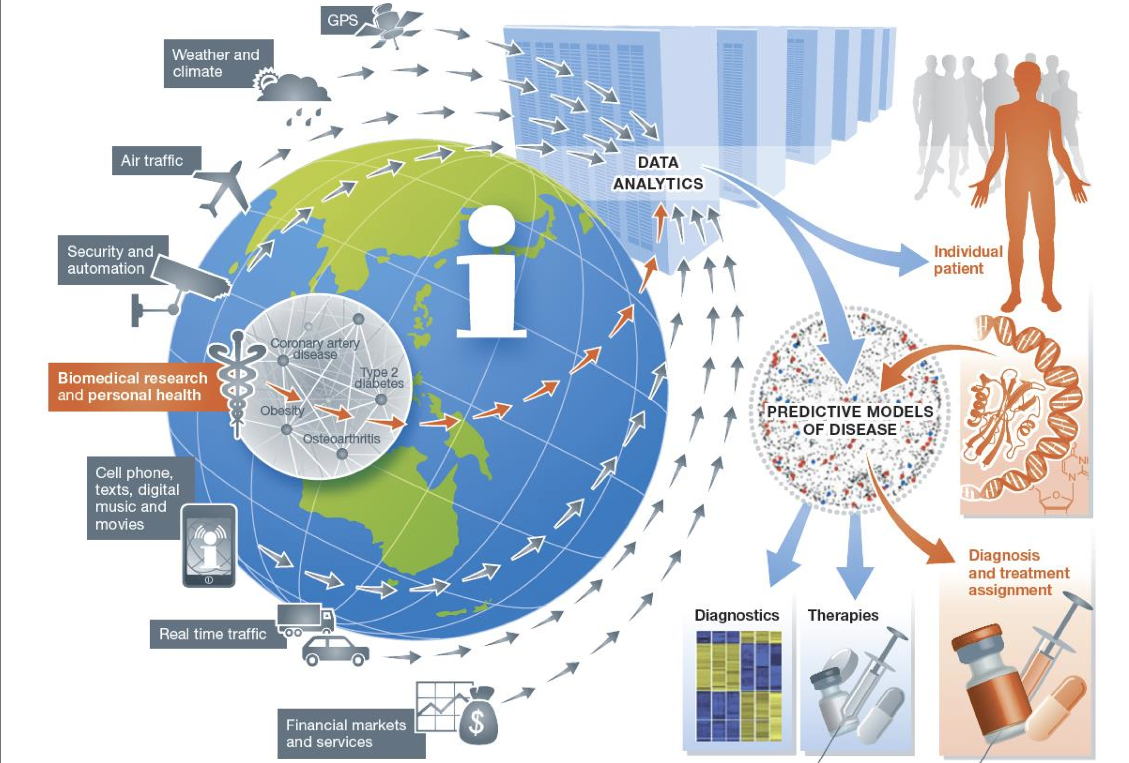
Data Ecosystem
Image: Eric Schadt

Slide 18
From Individual to Population
Key Use Cases

Slide 19
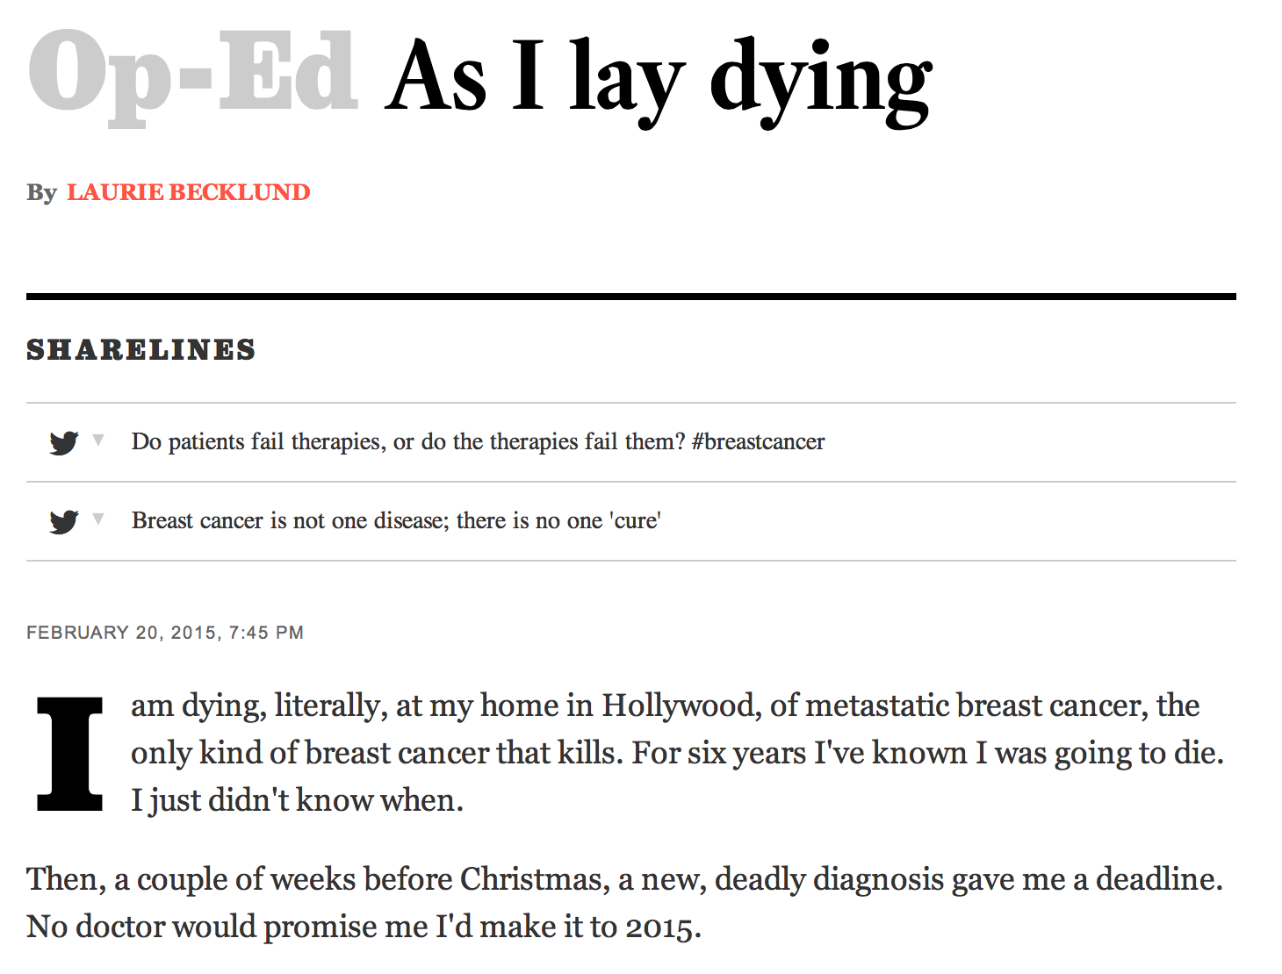
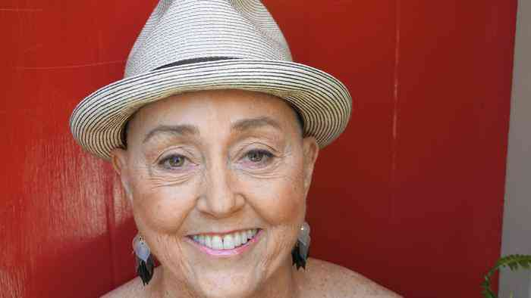
“We are each, in effect, one-person clinical trials”
“Yet the knowledge generated from those trials will die with us because there is no comprehensive database of metastatic breast cancer patients…. In the Big Data-era, this void is criminal.”

Slide 20
“The unfolding calamity in genomics is that a great deal of life-saving information, though already collected, is inaccessible.”
Antonio Regalado

Slide 21
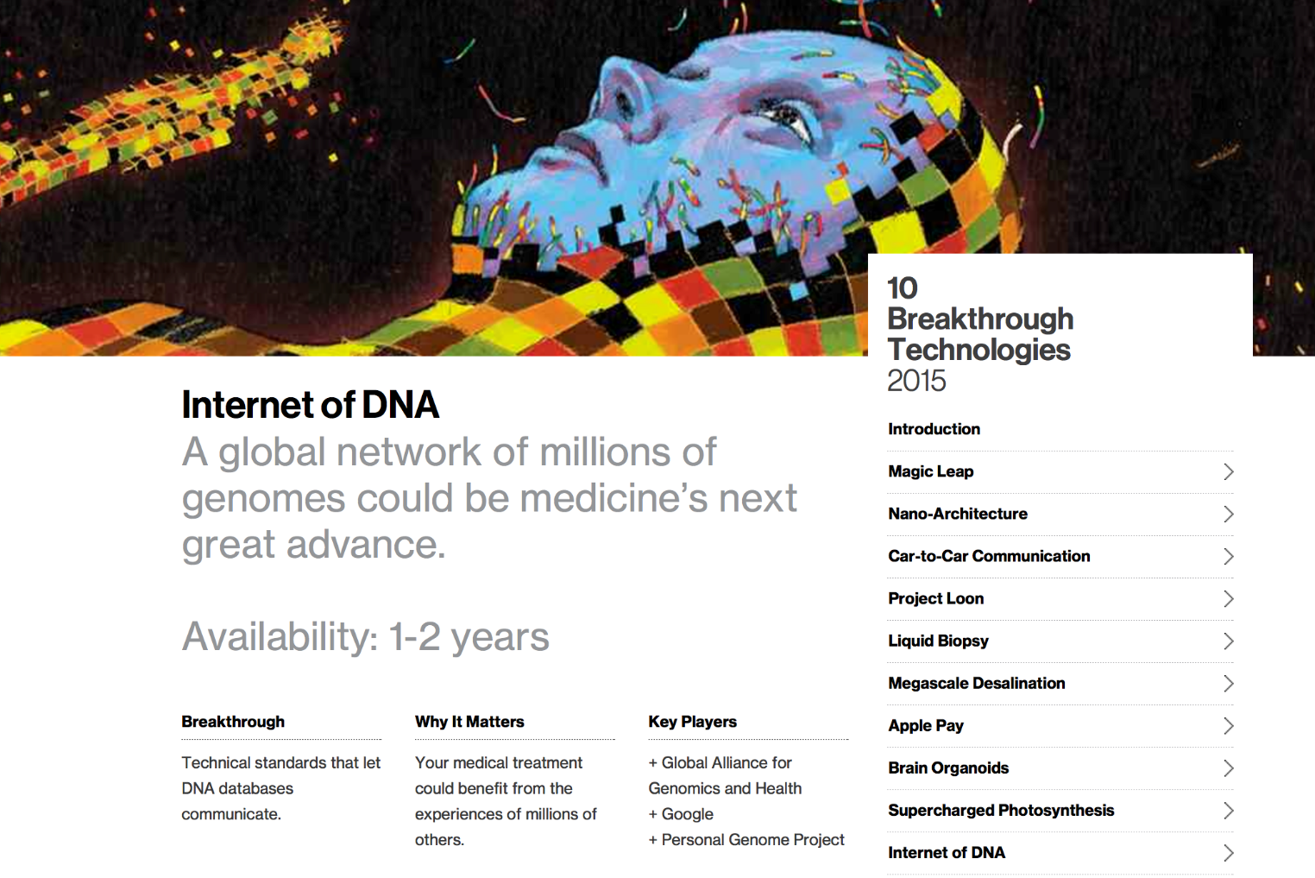
Internet of DNA
Source: Harvard Business Review

Slide 22
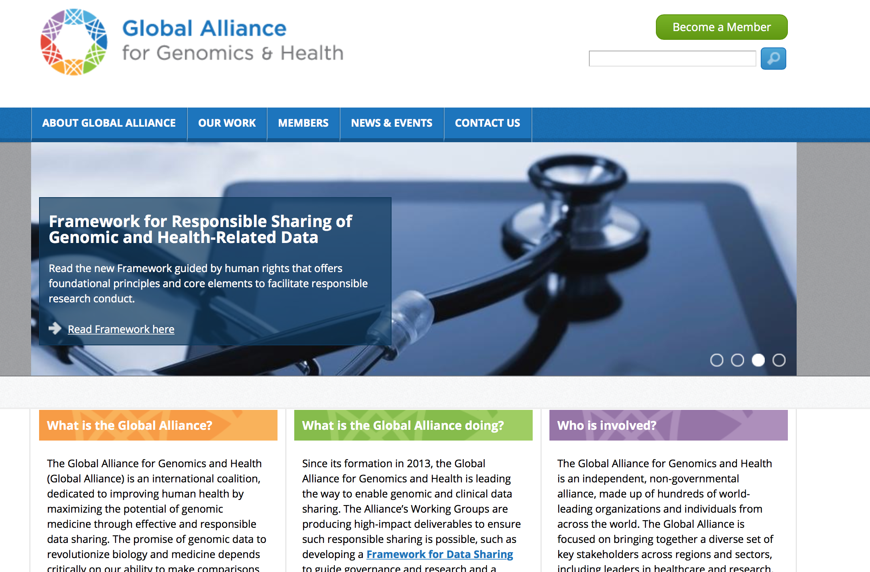
GA4GH http://genomicsandhealth.org

Slide 23

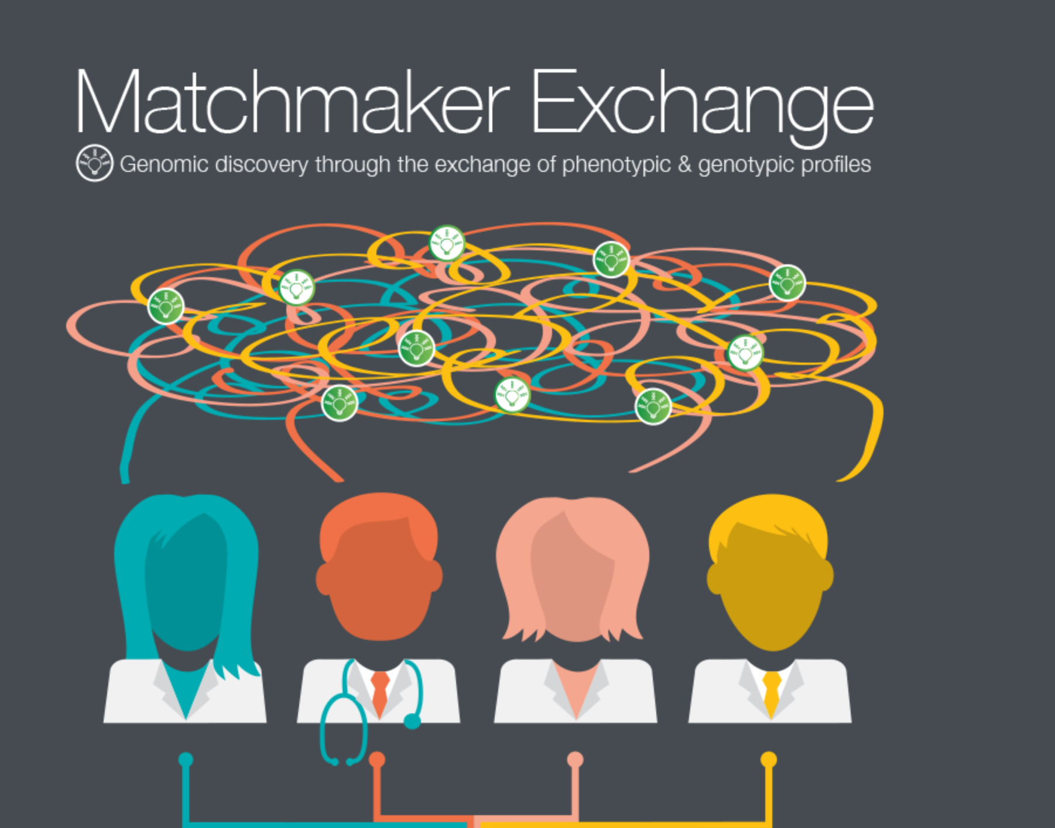
Matchmaker Exchange http://www.matchmakerexchange.org

Slide 24
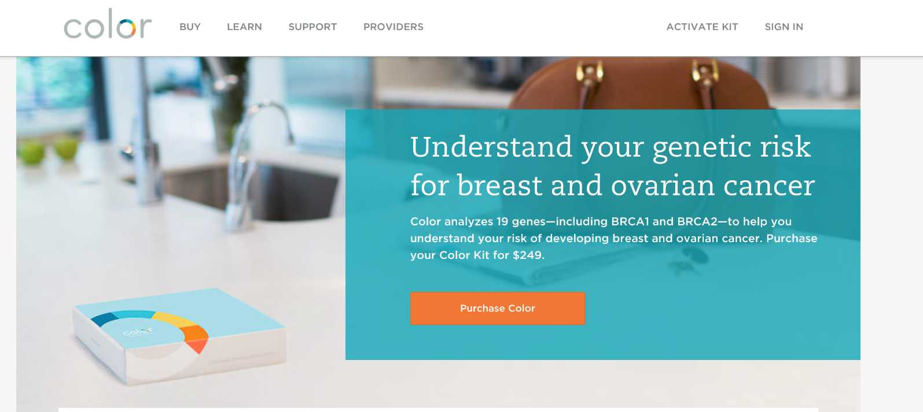
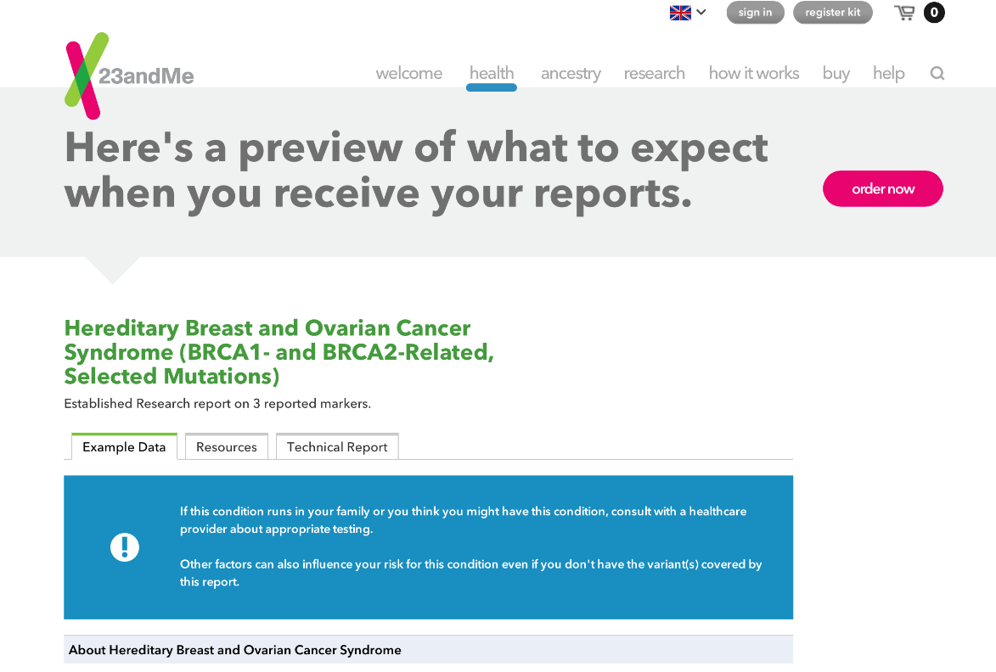
Consumer Genetic Testing

Slide 25
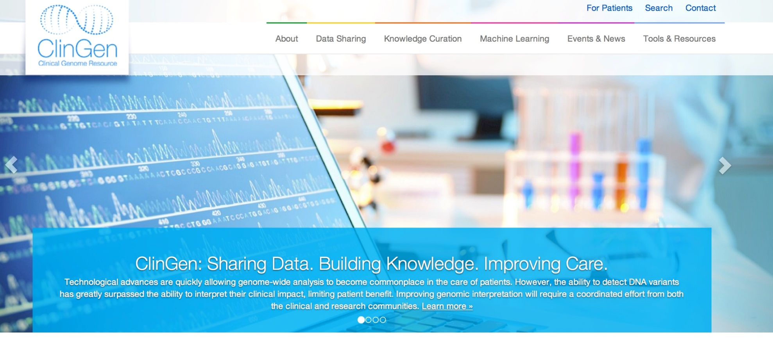
ClinGen http://clinicalgenome.org

Slide 26
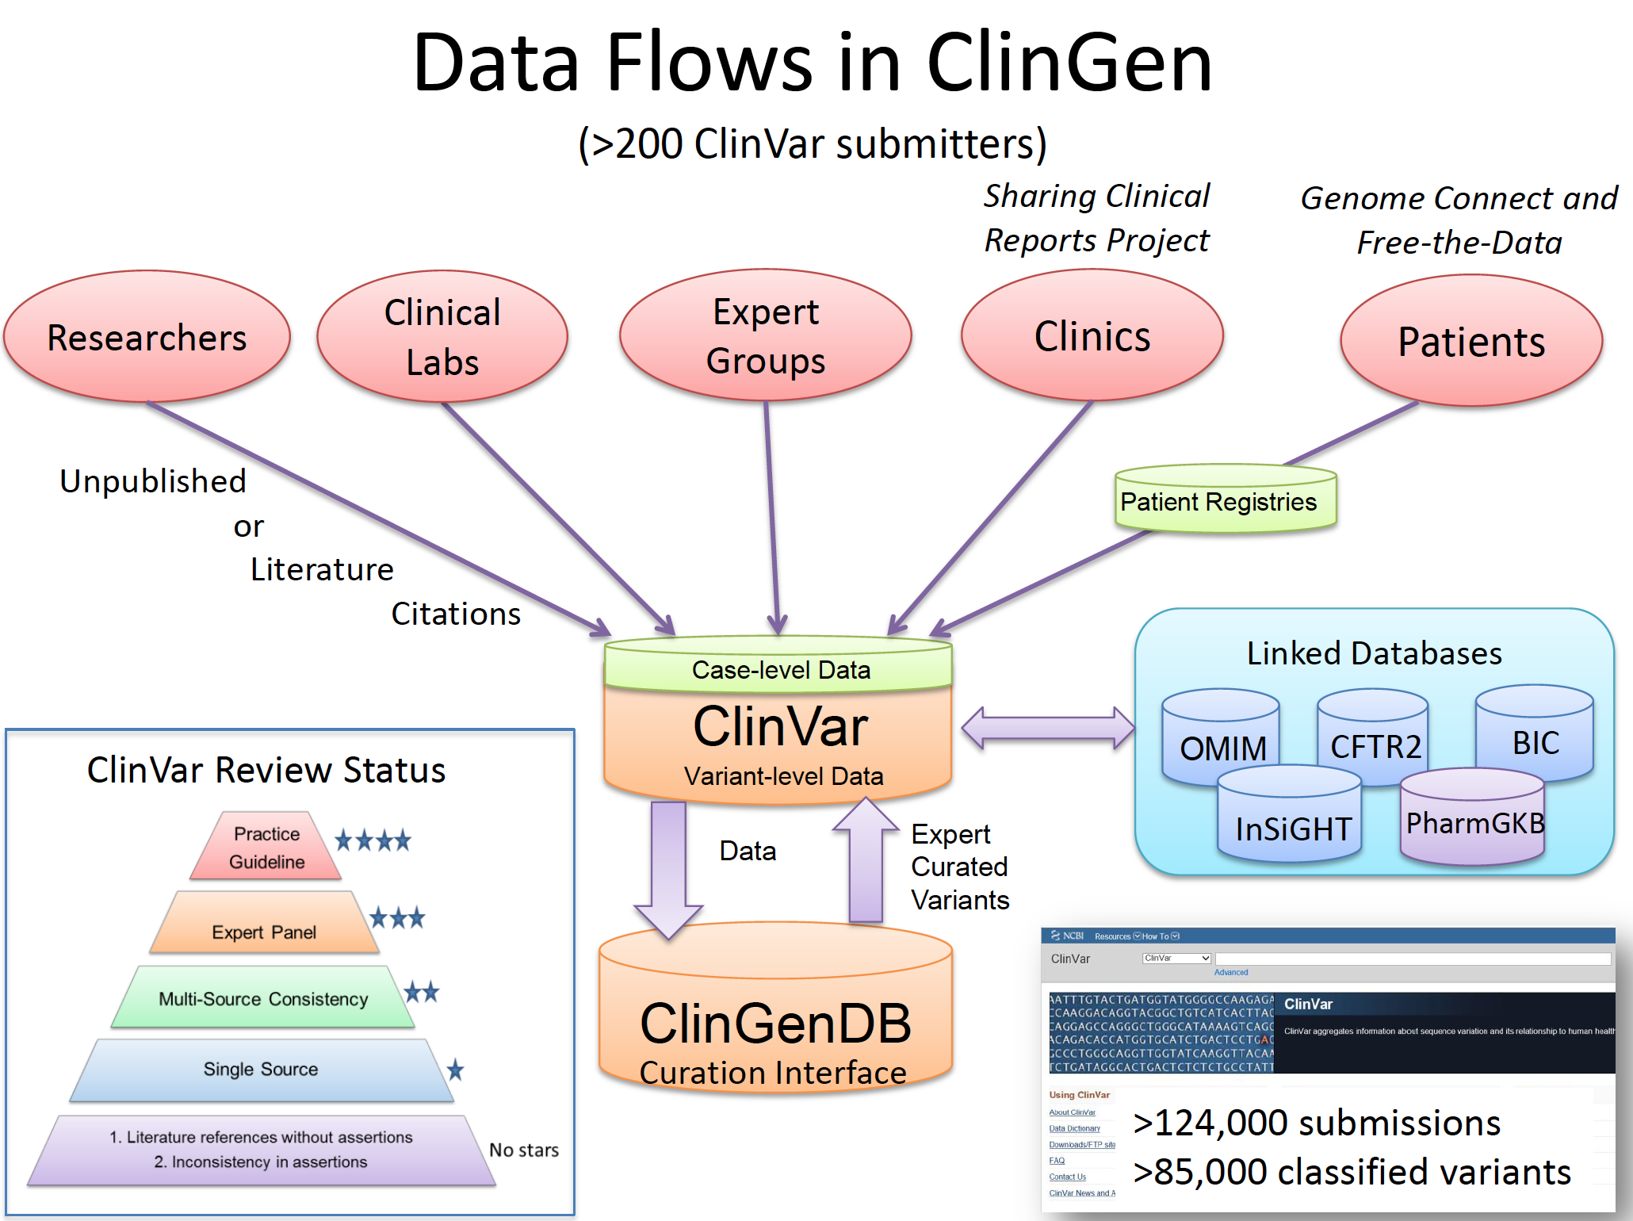
Image: Heidi Rehm

Slide 27
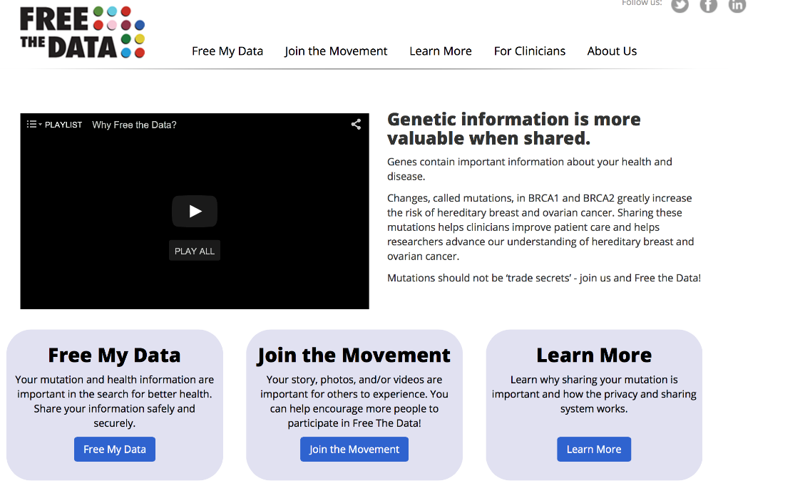
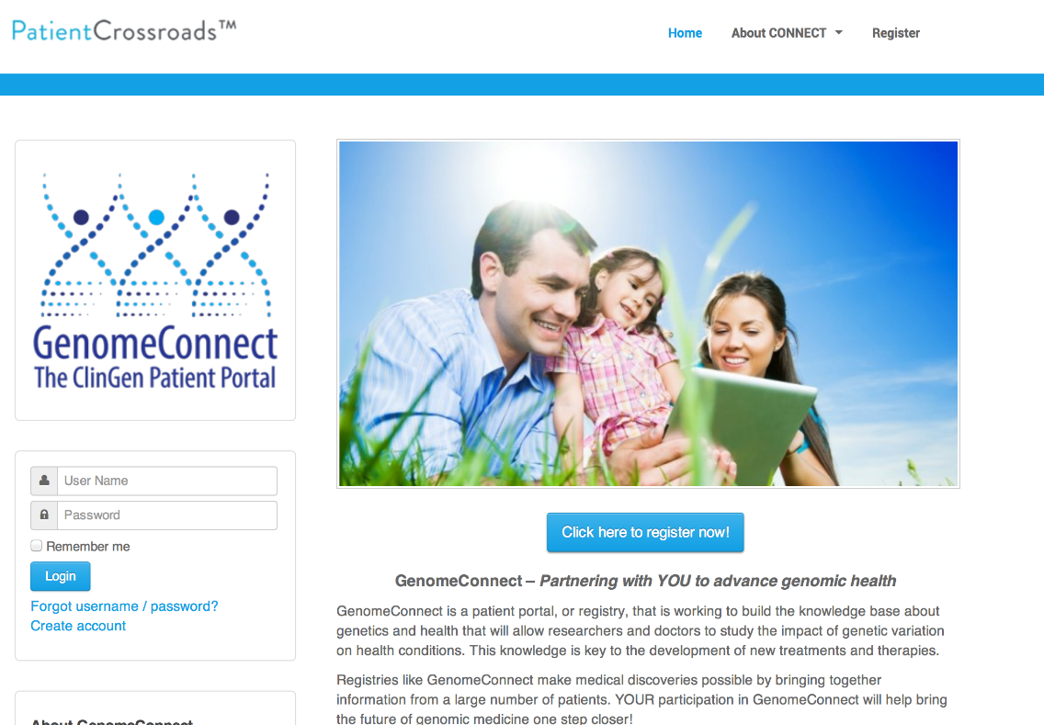
Patient Provided Data

Slide 28
Where we need to focus: Human-Data Interaction
Negotiability
Legibility
Agency
Notes:
Legiblity – transparency and comprehensible
Agency – control and interact with data related to them
Negotiability – change preferences

Slide 29
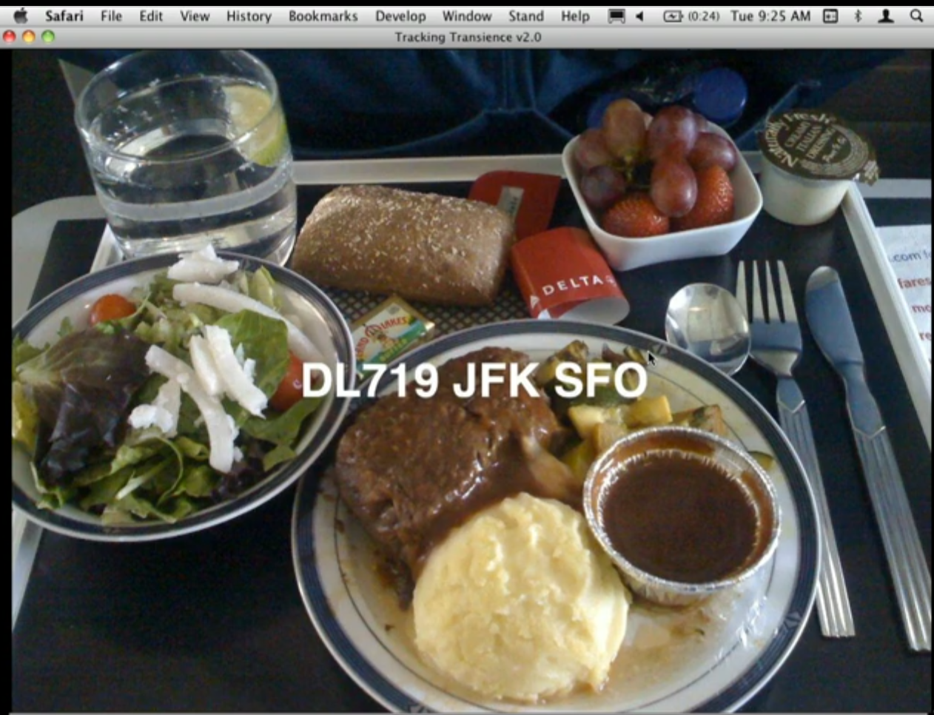
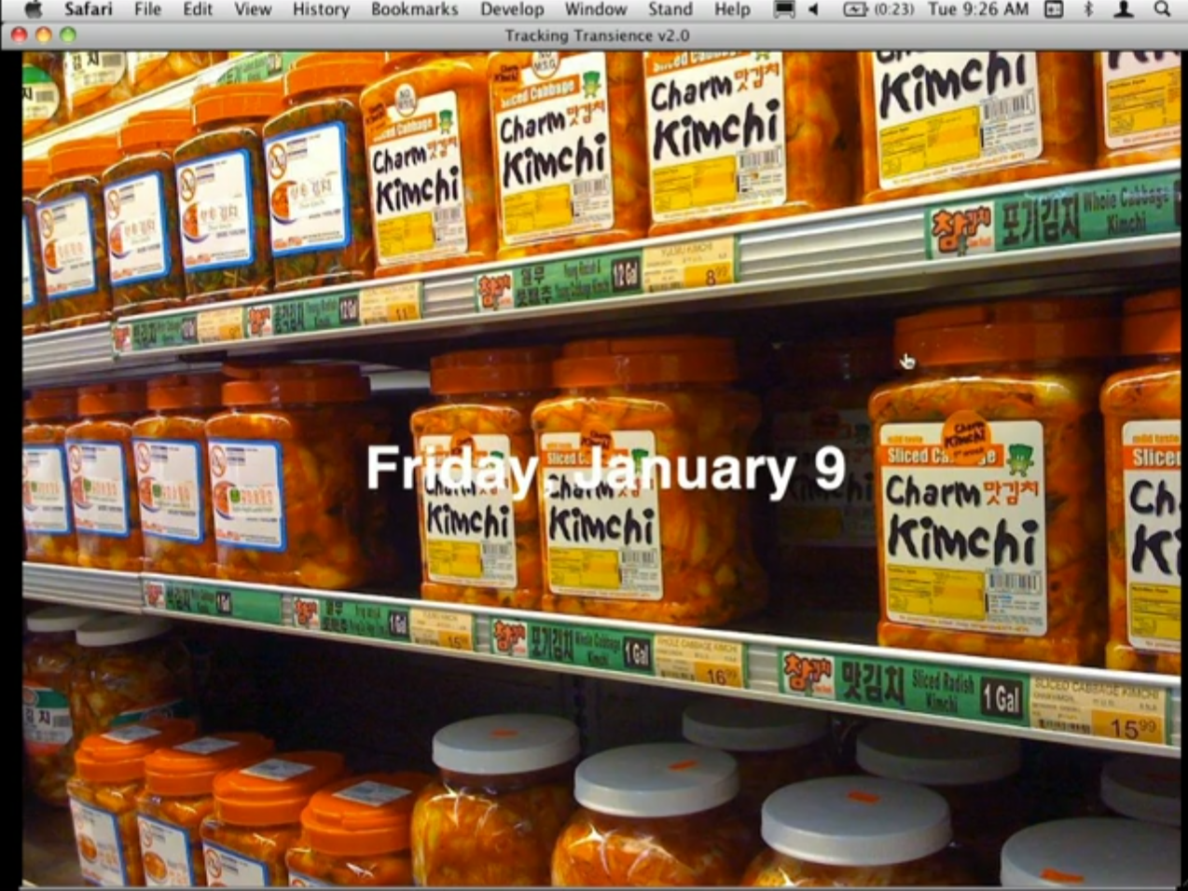
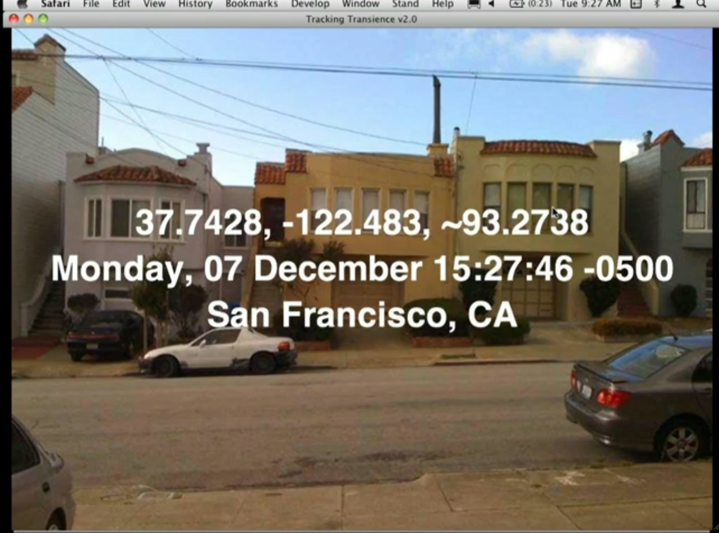
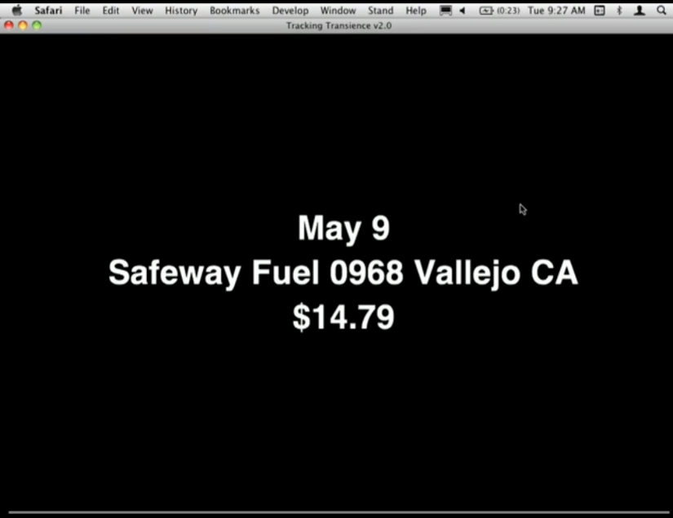
trackingtransience.net
Notes:
The way you protect your privacy Is to take control over it - if I give it you directly very different
Giving information makes info FBI has no value - Hasan Elahi

Slide 30
Transition to David Dorr

